Slide 1
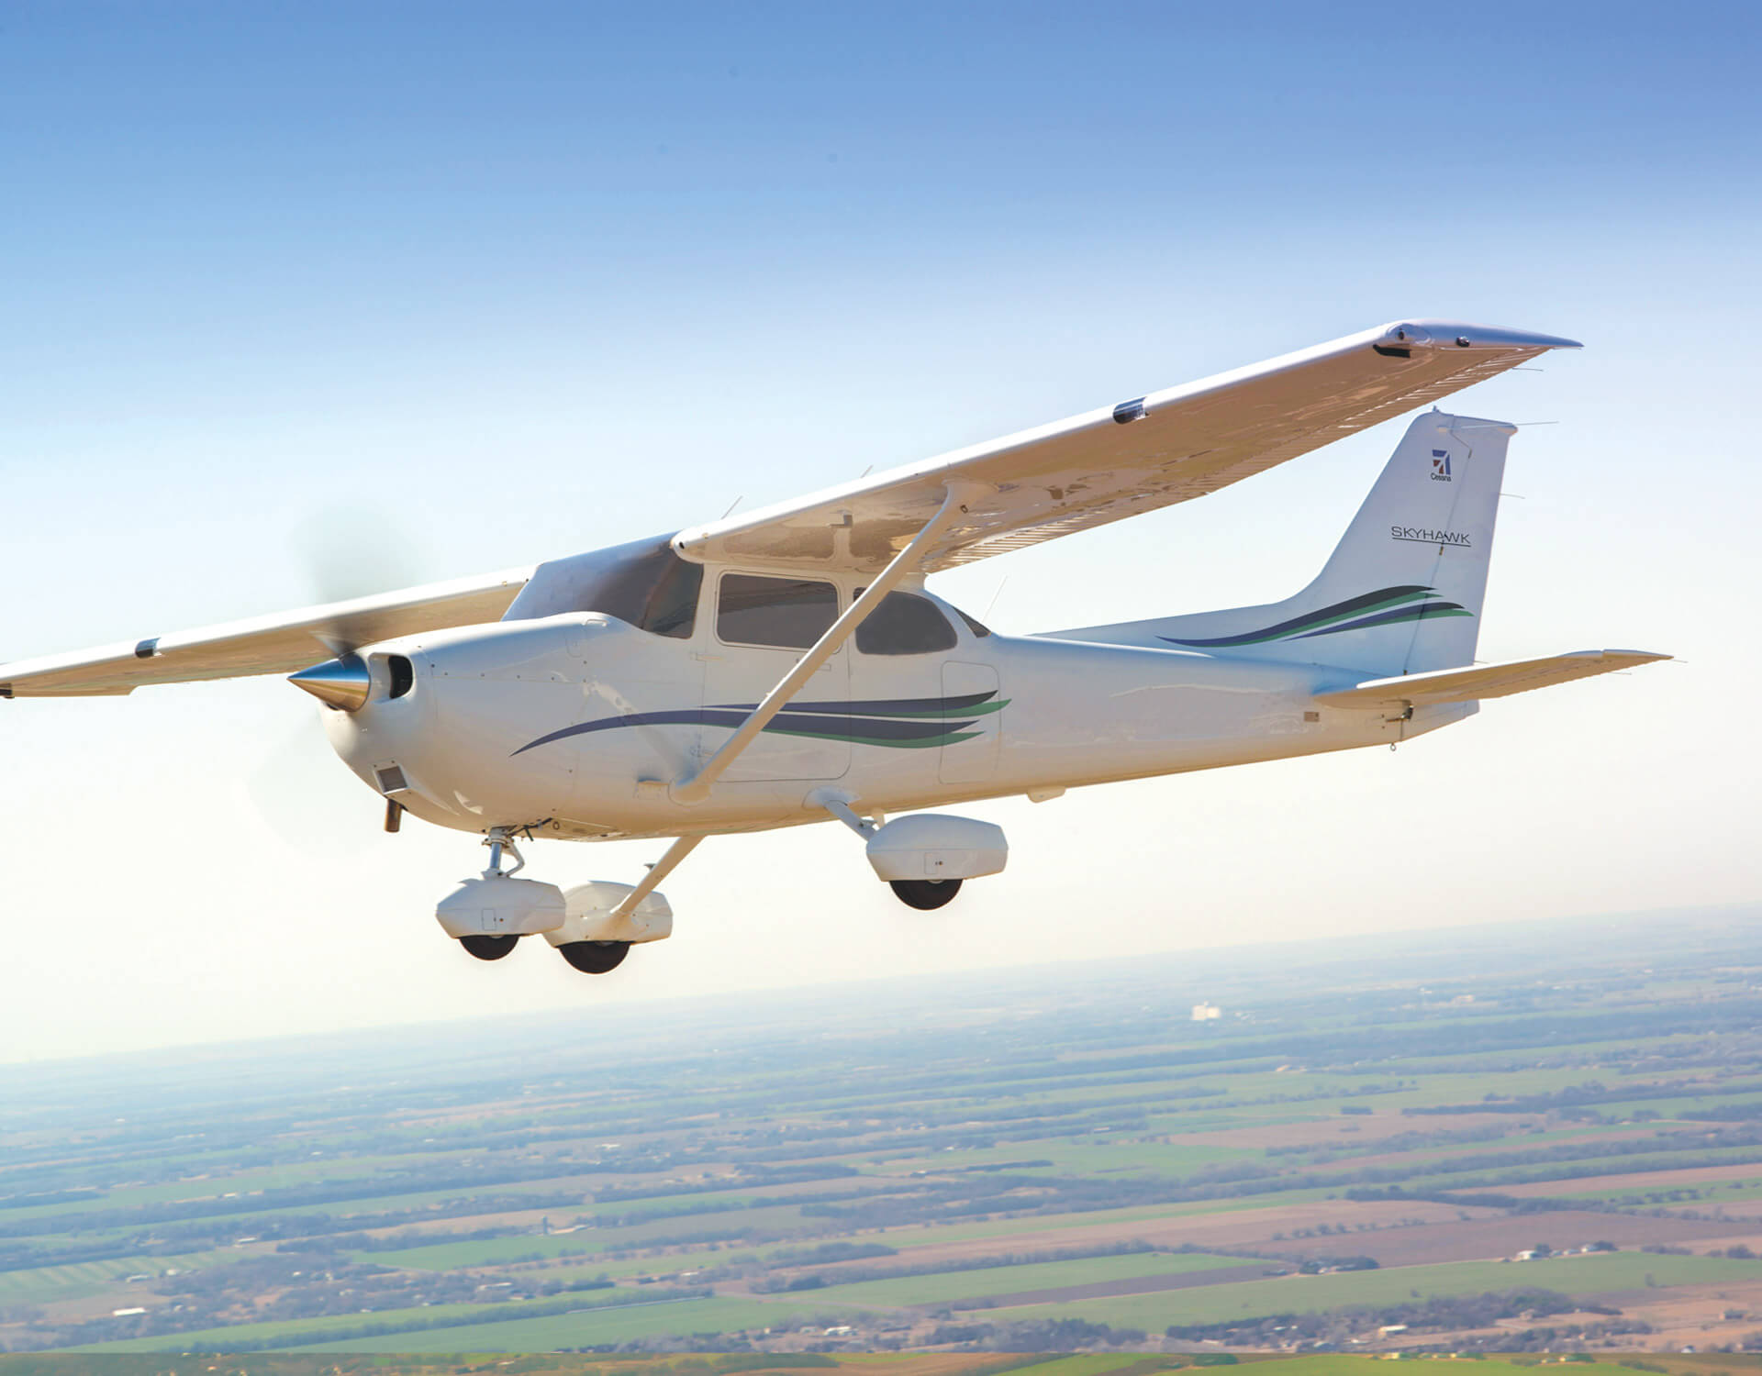

Predicting General Aviation Accident Cause based on Pilot Profile
Manuel Gomez

Slide 2
Problem
Yearly aviation accident rates have remained steady at around 1.0 fatal accident(s) per 100,000 flight hours with some recent years slowing a slight increase
As Improvements in automation and aircraft reliability continue, human factors are becoming the leading cause of aircraft accidents
To further decrease the aviation accident rate, human factors need to be targeted

Slide 3
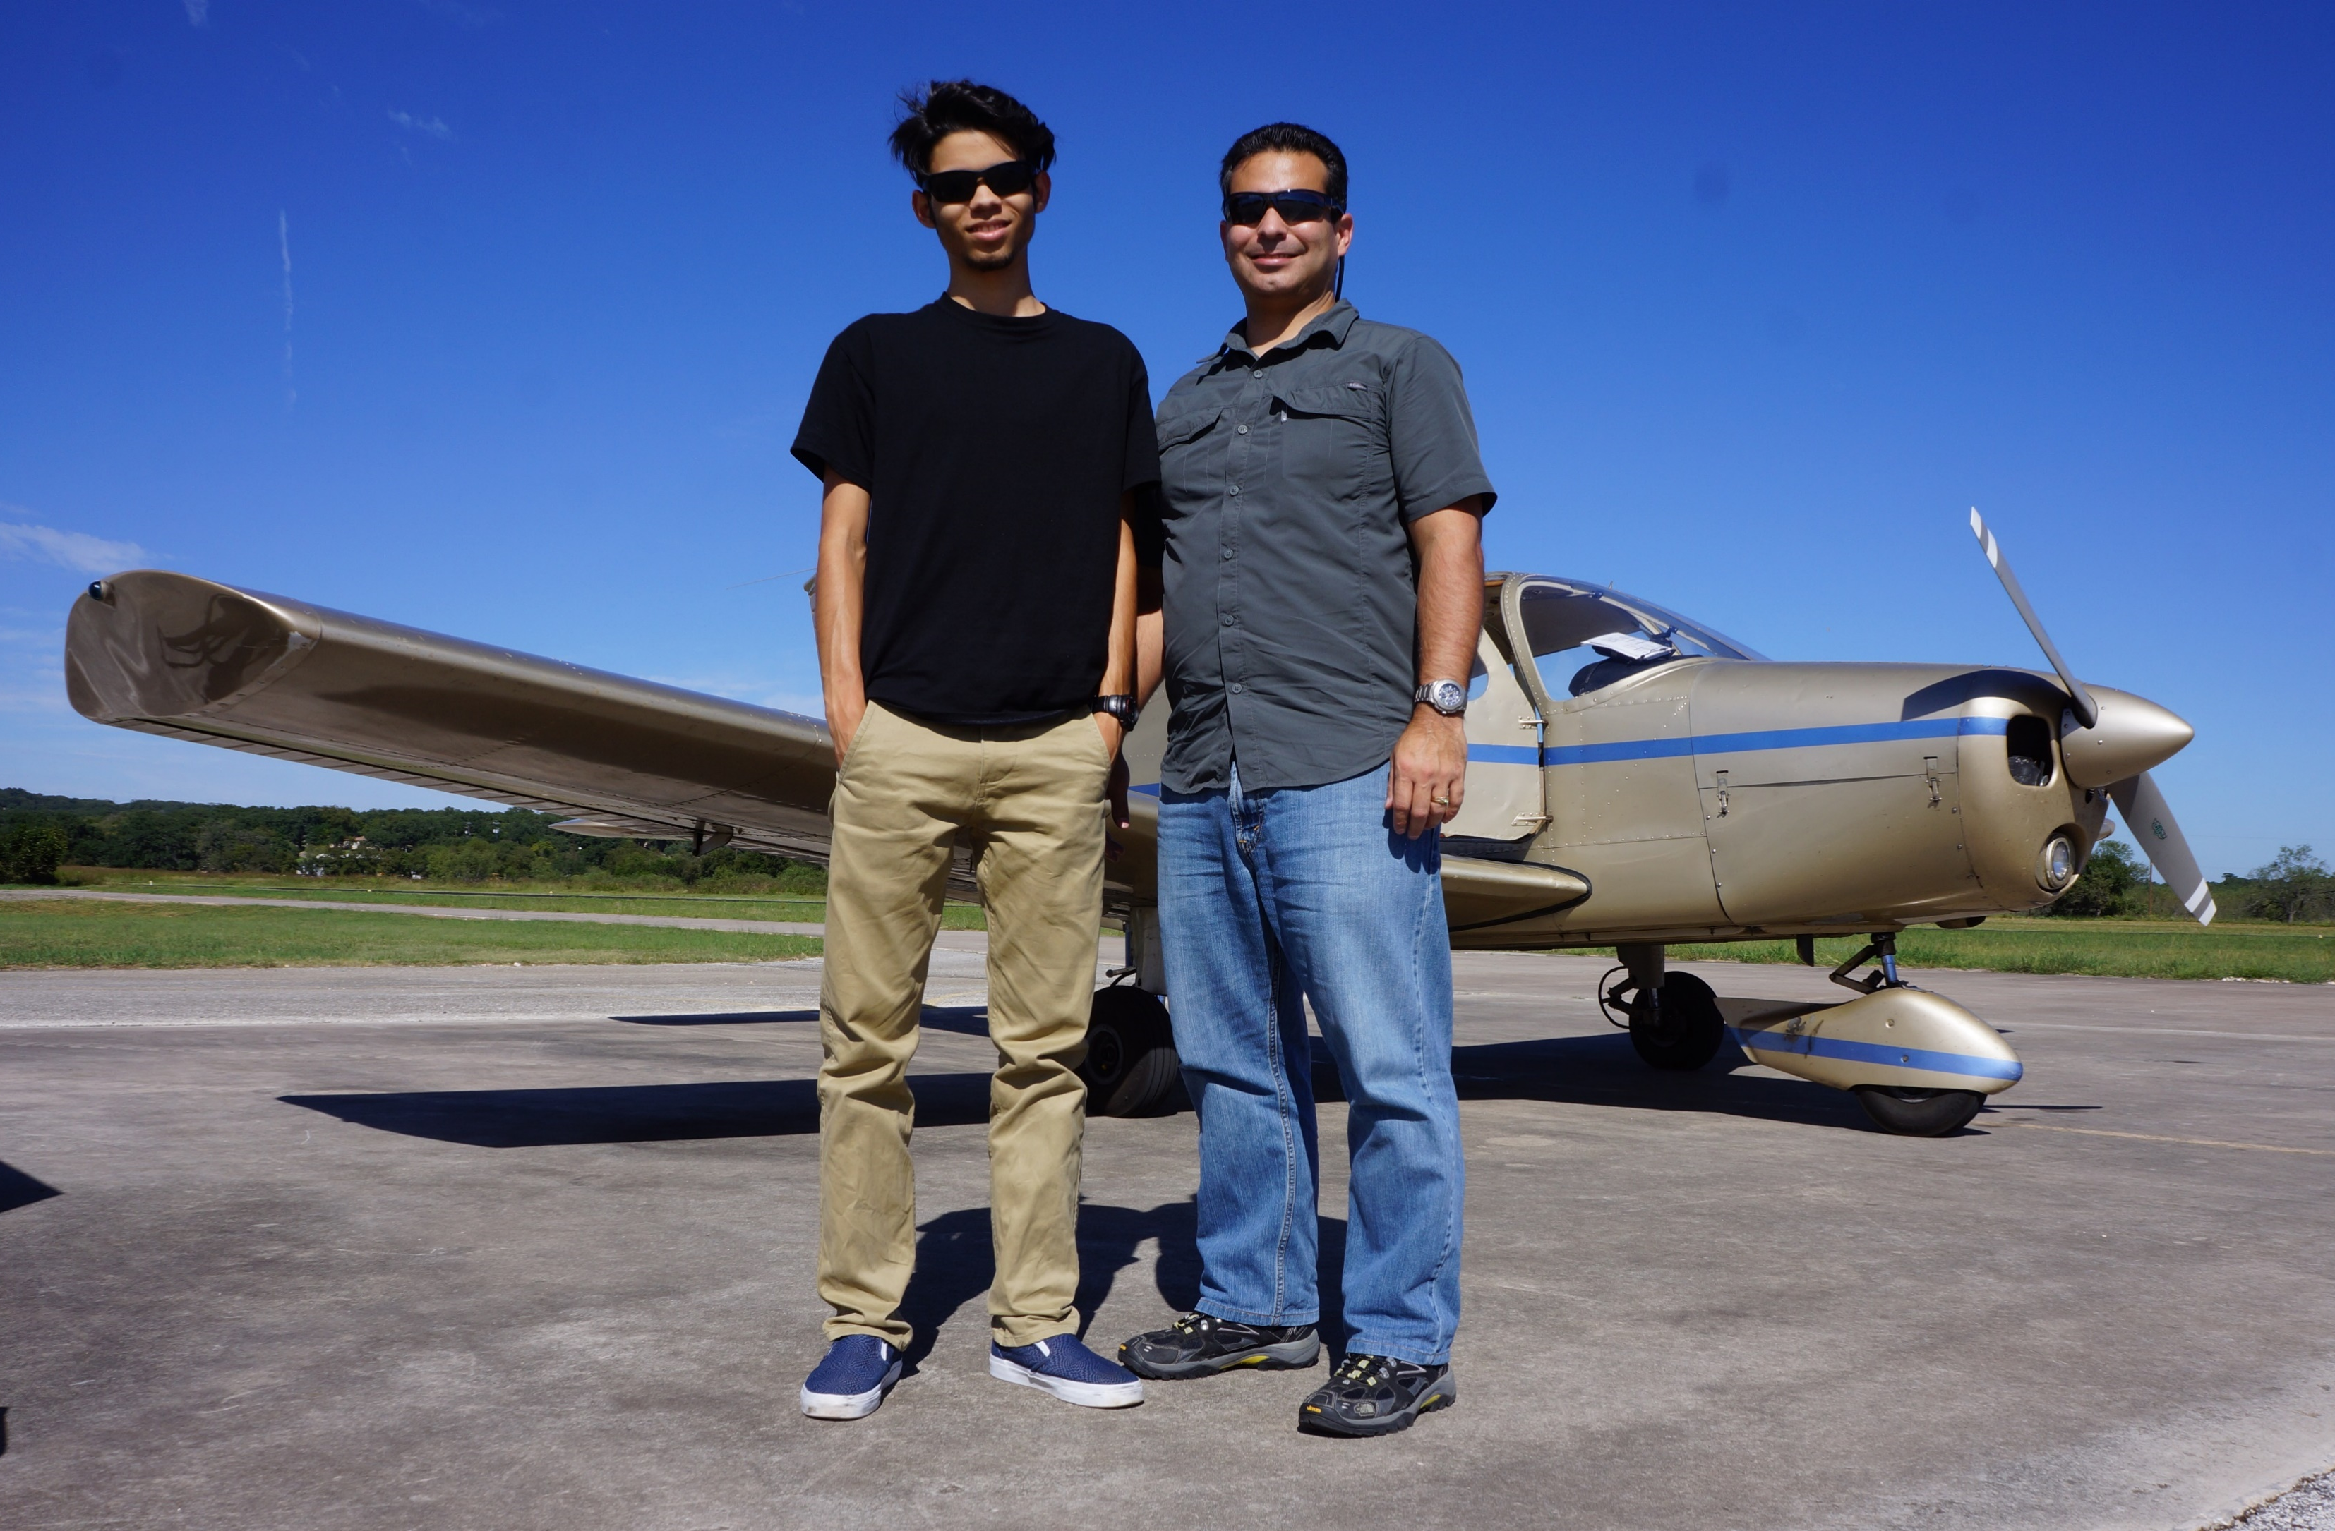

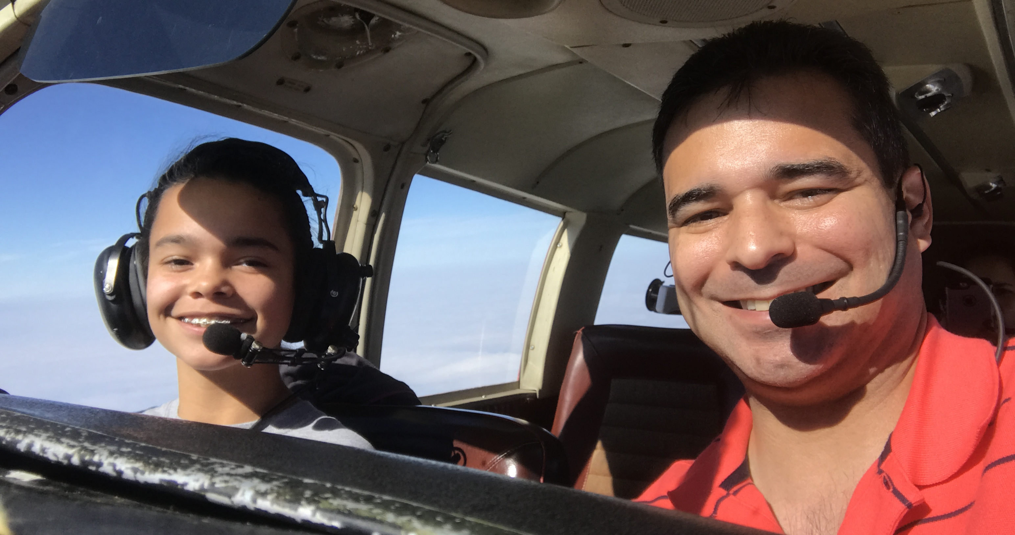
Stakeholders

Slide 4
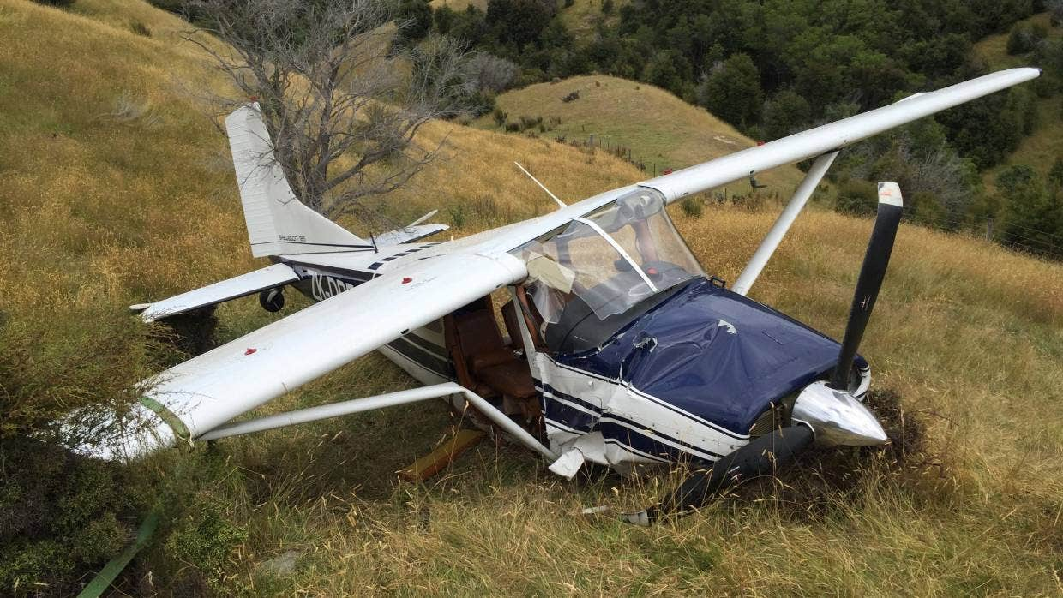
Proposal
Determine Pilot Profile
Predict Likely Accident
Provide Awareness / Targeted Training To Pilot

Slide 5
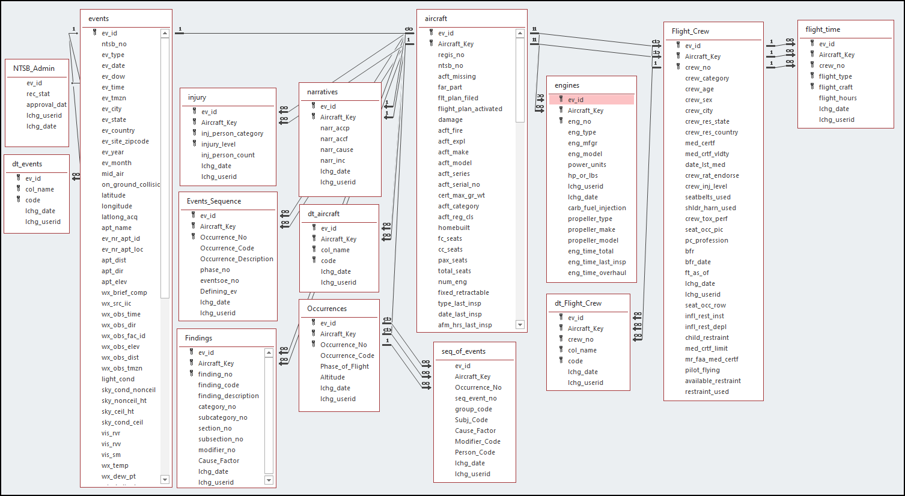
NTSB Aviation Accident Database
Records of interest
General Aviation Operations (Private, non-commercial flights)
Single Pilot Operations
34,900 Records
82 Features

Slide 6
Features
* Not all features represented
Numerical |  | Numerical | Categorical
Crew Age | Total Hours Instructor | Total Hours Instrument Flight | FAR Part | Pilot Privilege | Multi Engine Sea
Total Hours Flight Time | Total Hours in Accident Aircraft Type | Total Hours Night Instructor | Medical Certificate Type | Certificate Foreign | Airplane None
Total Hours Pilot in Command | Total Hours in Command of Accident Aircraft Type | Total Hours Multi Engine Instructor | Medical Certificate Valid | Certificate Military | Instructor Multi Engine
Total Hours Last 24 Hours | Total Hours in Instructor of Accident Aircraft Type | Total Hours Single Engine Instructor | Light Condition | Single Engine Land | Instructor Single Engine
Total Hours Last 30 Days | Total Hours Multi Engine | Total Hours Single Engine Instruction Received | Weather Condition | Multi Engine Land | Instructor Instrument
Total Hours Last 90 Days | Total Hours Night Instruction Received | Total Night Hours | Flight Type | Single Engine Sea
High Incidence of Missing Values
Engineered Feature

Slide 7

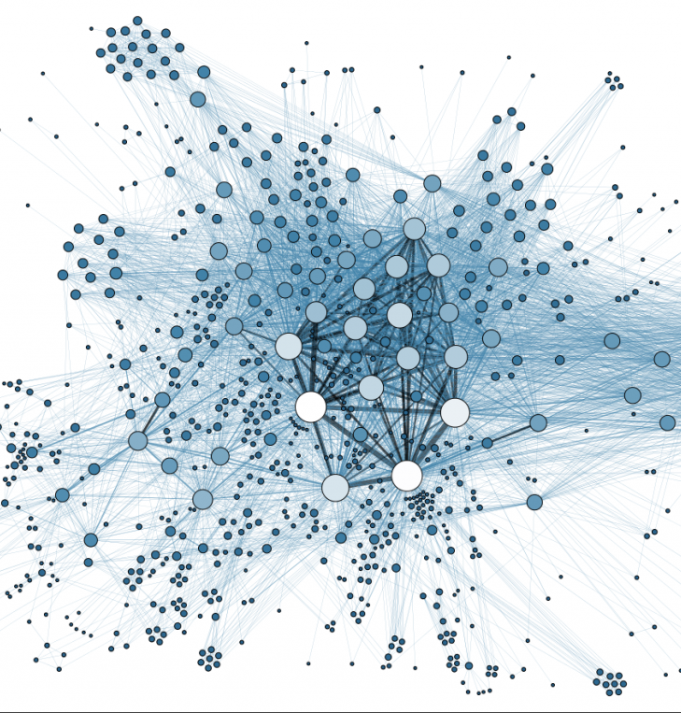
Data Wrangling
Codified data transcribed to plain English to aid in analysis
Missing Data
Age imputed based on overall pilot total hour – buckets
Some flight time imputed to minimum flight time required in category for type of certificate held
Data Validation
Algorithms checked for errors such as incompatible pilot certificates being held at the same time
Engineered Features
Medical Certificate Validity
Based on expiration date and date of accident
Pilot Privilege
Transcribed from One HOT Encode to Single Feature to aid analysis

Slide 8


Data Exploration
Questions
What is the overall correlation between features?
Is there a correlation between age and accident cause?
Is there a correlation between total flight hours and accident cause?
Is there a correlation between a pilot’s certificate privilege and accident cause?

Slide 9
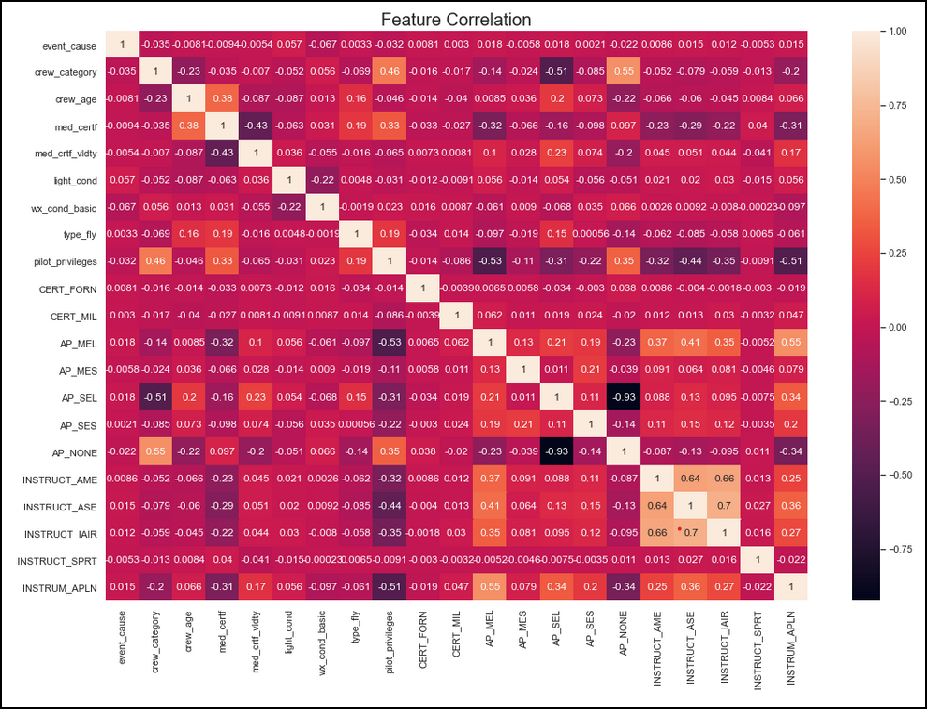
Correlation between
Categorical Features and Event Cause

Slide 10
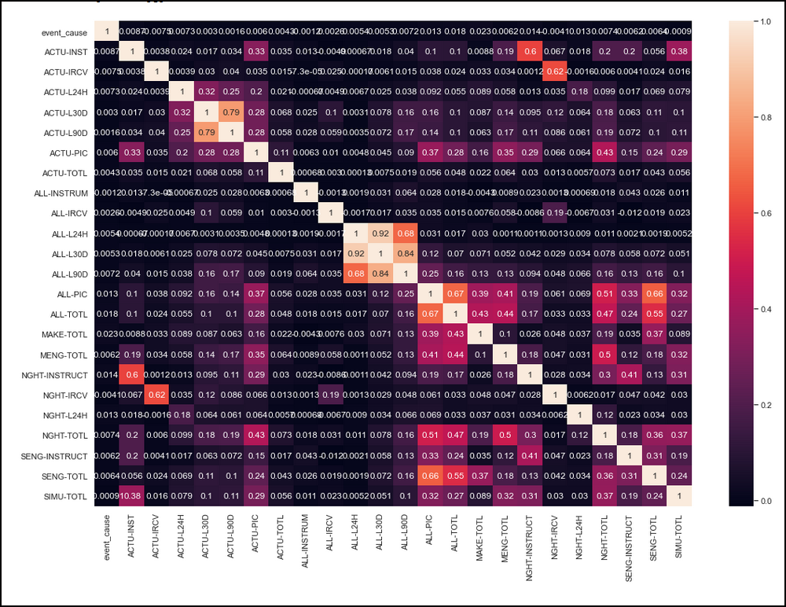
Correlation between
Numerical Features and Event Cause

Slide 11
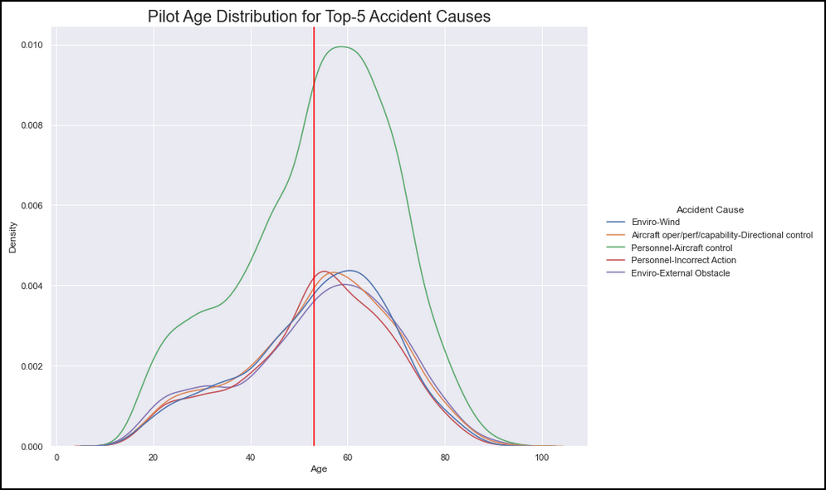
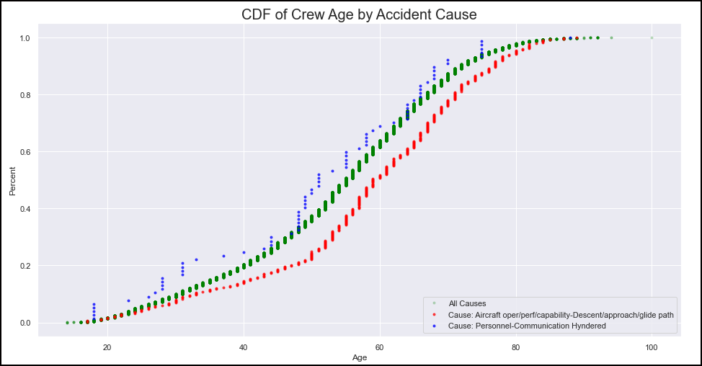
Age vs Accident Cause
No discernable difference in pilot
mean age among the top 5 aircraft
accident causes
Mean Age
Accident Cause with Lowest Mean Pilot Age
T test showed there is no difference in mean pilot age between pilots involved in these accident causes.
Accident Cause with Highest Mean Pilot Age

Slide 12
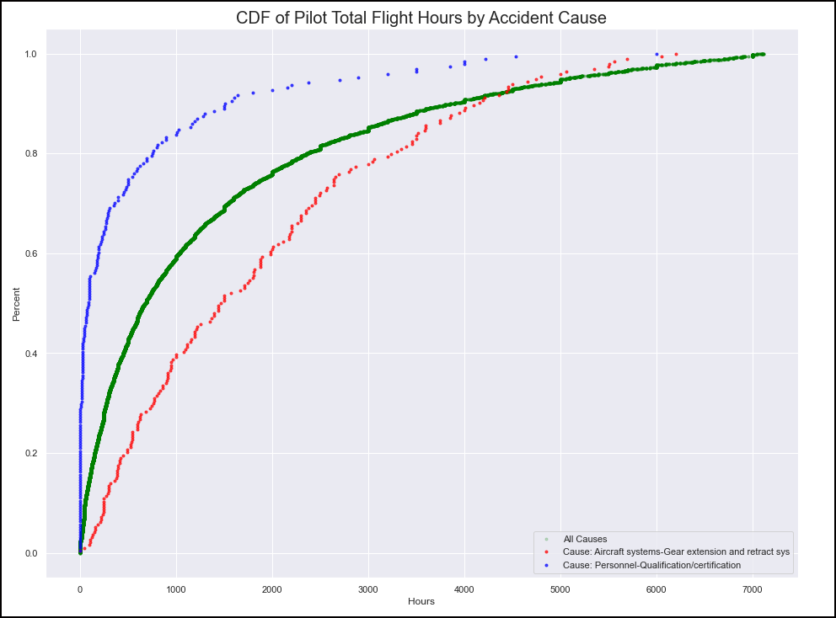
Accident Cause with Lowest Mean Pilot Total Flight Hour
T test showed there is little to no difference in the mean total flight time between pilots involved in these accident causes
Because these accident causes are at the extremes (lowest vs. highest) it follows that there is no statistical difference in pilot’s mean total flight time between any accident cause
Accident Cause with Highest Mean Pilot Total Flight Hour

Slide 13
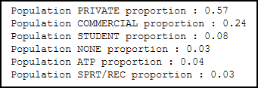
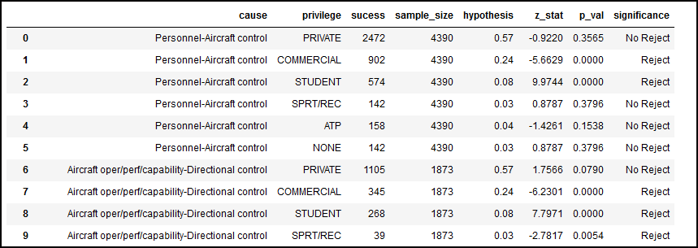
Does Pilot Certificate Privilege influence Accident Cause
Population
Proportions
Sample Proportions
Success / Sample Size
There are 232 instances out of 702 where the sample proportion does not match the population proportion
Pilot Certificate Privilege may help in classification in some cases

Slide 14
Conclusions on Data Analysis
There is no clear correlation between any one feature and accident cause
Many numerical features have a significant number of missing values and these cannot be reasonably imputed
Pilot certificate privilege has the potential to aid in classification but only in some cases

Slide 15

Modeling (Python SKLearn)
Model | n_estimators* | Accuracy
Decision Tree |  | 0.13
Random Forrest | 100 | 0.19
ADABoost Classifier | 100 | 0.37
GradientBoost Classifier | 100 | 0.37
ADABoost Classifier (PCA = 20)** | 100 | 0.39
* determined via GridSearchCV
** PCA 20 selected to account for 80% of variance
Support Vector Machine (PCA = 20) Accuracy 0.39
Parameters | Options (RandomizedSearchCV)
C | 0.1 | 1 | 10 | 100
Gamma | 1 | 0.1 | 0.001 | 0.0001
Kernel | Linear
Decision Function Shape | OVO |  | OVR

Slide 16
Modeling
SVM Confusion Matrix
 | Cause 1 | Cause 2 | Cause 3 | Cause 4 | Cause 5
Cause 1 | 0 | 0 | 0 | 446 | 0
Cause 2 | 6 | 0 | 0 | 404 | 0
Cause 3 | 0 | 0 | 0 | 379 | 0
Cause 4 | 0 | 0 | 0 | 1059 | 0
Cause 5 | 0 | 11 | 0 | 387 | 0
ADABoost Classifier Confusion Matrix
 | Cause 1 | Cause 2 | Cause 3 | Cause 4 | Cause 5
Cause 1 | 7 | 1 | 3 | 440 | 9
Cause 2 | 6 | 10 | 4 | 378 | 6
Cause 3 | 9 | 2 | 4 | 358 | 6
Cause 4 | 18 | 10 | 5 | 1010 | 16
Cause 5 | 5 | 11 | 2 | 357 | 12
ADABoost Classifier
Final Model
Accuracy 0.39

Slide 17
Conclusion
Effort failed to produce a deployable model
Issues with missing data (flight hours)
Not including aircraft Type/Model in analysis
Future work
Improve NTSB accident data collection
Make data collection mandatory for all time-related fields
Reattempt analysis including aircraft Type/Model
Time commitment to clean data set will be considerable

